Slide 1
Chapter 3: Dynamic Routing
Instructor Materials
CCNA Routing and Switching
Routing and Switching Essentials v6.0
Notes:
Cisco Networking Academy Program
Routing and Switching Essentials v6.0
Chapter 3: Dynamic Routing

Slide 2
Instructor Materials – Chapter 3 Planning Guide
This PowerPoint deck is divided in two parts:
Instructor Planning Guide
Information to help you become familiar with the chapter
Teaching aids
Instructor Class Presentation
Optional slides that you can use in the classroom
Begins on slide # 12
Note: Remove the Planning Guide from this presentation before sharing with anyone.
Notes:
2

Slide 3
Chapter 3: Dynamic Routing
Routing and Switching Essentials v6.0 Planning Guide
Notes:
Cisco Networking Academy Program
Routing and Switching Essentials v6.0
Chapter 3: Dynamic Routing

Slide 4
Chapter 3: Activities
What activities are associated with this chapter?
Page # | Activity Type | Activity Name | Optional?
3.0.1.2 | Class Activity | How Much Does This Cost | Optional
3.1.2.5 | Interactive Activity | Compare Static and Dynamic Routing | Recommended
3.2.1.2 | Syntax Checker | Advertising the R2 and R3 Networks | Recommended
3.2.1.3 | Syntax Checker | Verifying RIP Settings and Routes on R2 and R3 | Recommended
3.2.1.4 | Syntax Checker | Enable and Verify RIPv2 on R2 and R3 | Recommended
3.2.1.5 | Syntax Checker | Disable Automatic Summarization on R2 and R3 | Recommended
3.2.1.6 | Syntax Checker | Configuring and Verifying a Passive Interface on R2 and R3 | Recommended
3.2.1.7 | Syntax Checker | Verifying the Gateway of Last Resort on R2 and R3 | Recommended
3.2.1.8 | Packet Tracer | Configuring RIPv2 | Recommended
3.2.1.9 | Lab | Configuring Basic RIPv2 | Optional
The password used in the Packet Tracer activities in this chapter is: PT_ccna5
Notes:
4

Slide 5
Chapter 3: Activities (Cont.)
What activities are associated with this chapter?
Page # | Activity Type | Activity Name | Optional?
3.3.1.4 | Interactive Activity | Identify Parts of an IPv4 Routing Table Entry | Recommended
3.3.2.6 | Interactive Activity | Identify Parent and Child IPv4 Routes | Recommended
3.3.3.3 | Interactive Activity | Determine the Longest Match Route | Recommended
3.3.4.4 | Interactive Activity | Identify Parts of an IPv6 Routing Table Entry | Recommended
3.4.1.1 | Class Activity | IPv6, Details, Details… | Optional
The password used in the Packet Tracer activities in this chapter is: PT_ccna5
Notes:
5

Slide 6
Chapter 3: Assessment
Students should complete Chapter 3, “Assessment” after completing Chapter 3.
Quizzes, labs, Packet Tracers and other activities can be used to informally assess student progress.
Notes:
6

Slide 7
Chapter 3: Best Practices
Prior to teaching Chapter 3, the instructor should:
Complete Chapter 3, “Assessment.”
The objectives of this chapter are:
Explain the purpose of dynamic routing protocols.
Explain the use of dynamic routing and static routing.
Configure the RIPv2 routing protocol.
Explain the components of an IPv4 routing table entry for a given route.
Explain the parent/child relationship in a dynamically built routing table.
Determine which route will be used to forward a IPv4 packet.
Determine which route will be used to forward a IPv6 packet.
Notes:
7

Slide 8
Chapter 3: Best Practices (Cont.)
3.1
Create topologies in Packet Tracer similar to the topologies in the chapter and demonstrate static versus dynamic routing. Stress the advantages and disadvantages of static and dynamic routing.
Introduce terms such as metrics, convergence, distance vector, link state, classless, classful, IGP, and EGP.
During this chapter, consider setting up a large network as a Packet Tracer demonstration to allow students to see size and complexity.
3.2
Demonstrate each RIP command using Packet Tracer.
Recommend that students do the Syntax checkers in this section to aid in memorizing commands and interpreting error messages.
Follow-up with the recommended lab, 3.2.1.8 Configuring RIPv2.
Notes:
8

Slide 9
Chapter 3: Best Practices (Cont.)
3.3
Stress the importance of understanding the entries in the routing table, particularly for troubleshooting.
Provide students with a variety of example networks using Packet Tracer and challenge them to interpret the routing table entries.
Create the reference topology in section 3.3.1 in Packet Tracer and use that to demonstrate directly connected and dynamically learned IPv4 routes. Also use it to explain router lookup.
Create the reference topology in section 3.3.4 in Packet Tracer and use that to demonstrate the IPv6 routing table entries as well as router lookup.
Recommend that students complete the activities 3.3.1.4, 3.3.3.3 and 3.3.4.4 to reinforce their understanding.
Notes:
9

Slide 10
Chapter 3: Additional Help
For additional help with teaching strategies, including lesson plans, analogies for difficult concepts, and discussion topics, visit the CCNA Community at: https://www.netacad.com/group/communities/community-home
Best practices from around the world for teaching CCNA Routing and Switching. https://www.netacad.com/group/communities/ccna
If you have lesson plans or resources that you would like to share, upload them to the CCNA Community in order to help other instructors.
Students can enroll in Introduction to Packet Tracer (self-paced).
Notes:
10

Slide 12
Chapter 3: Dynamic Routing
CCNA Routing and Switching
Routing and Switching Essentials v6.0
Notes:
Cisco Networking Academy Program
Routing and Switching Essentials v6.0
Chapter 3: Dynamic Routing

Slide 13
Chapter 3 - Sections & Objectives
3.1 Dynamic Routing Protocols
Explain the function of dynamic routing protocols.
Explain the purpose of dynamic routing protocols.
Explain the use of dynamic routing and static routing.
3.2 RIPv2
Implement RIPv2.
Configure the RIPv2 routing protocol.
3.3 The Routing Table
Determine the route source, administrative distance, and metric for a given route.
Explain the components of an IPv4 routing table entry for a given route.
Explain the parent/child relationship in a dynamically built routing table.
Determine which route will be used to forward a IPv4 packet.
Determine which route will be used to forward a IPv6 packet.
Notes:
13
Cisco Networking Academy Program
Routing and Switching Essentials v6.0
Chapter 3: Dynamic Routing

Slide 14
3.1 Dynamic Routing Protocols
Notes:
3 – Dynamic Routing
3.1 – Dynamic Routing Protocols

Slide 15
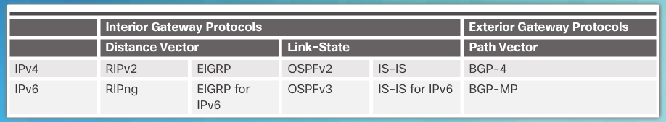
Dynamic Routing Protocol Overview Dynamic Routing Protocol Overview
RIP protocol was updated to RIPv2 to accommodate growth in the network environment
RIPv2 does not scale to current larger network implementations
Routing Protocols developed to meet the need of larger networks include:
Open Shortest Path First (OSPF)
Intermediate System-to-Intermediate System (IS-IS).
Enhanced IGRP (EIGRP)
Border Gateway Protocol (BGP) is used between Internet service providers (ISPs)
.
Notes:
3.1 – Dynamic Routing Protocols
3.1.1 – Dynamic Routing Protocol Overview
3.1.1.1 – Dynamic Routing Protocol Overview

Slide 16
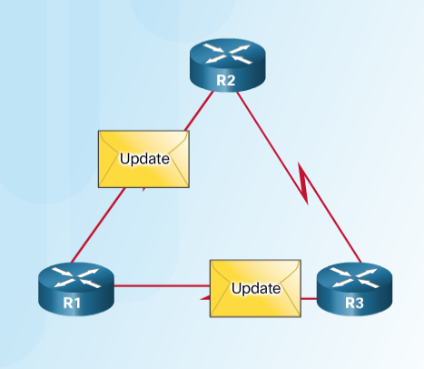
Dynamic Routing Protocol Overview Dynamic Routing Protocol Components
Purpose of dynamic routing protocols includes:
Discovery of remote networks
Maintaining up-to-date routing information
Choosing the best path to destination networks
Ability to find a new best path if the current path is no longer available
The main components of dynamic routing protocols include:
Data structures - tables or databases kept in RAM.
Routing protocol messages - to discover neighboring routers, exchange routing information, and maintain accurate information about the network.
Algorithms – to facilitate learning routing information and for best path determination.
Notes:
3.1 – Dynamic Routing Protocols
3.1.1 – Dynamic Routing Protocol Overview
3.1.1.2 – Dynamic Routing Protocol Components

Slide 17
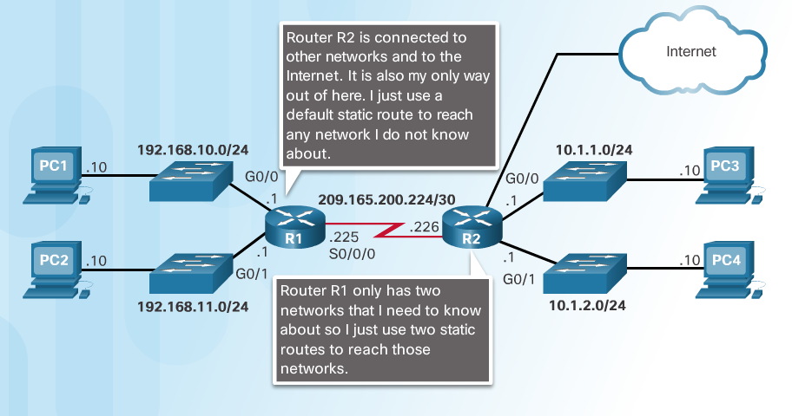
Dynamic versus Static Routing Static Routing Uses
Networks often use both static and dynamic routing.
Static Routing is used as follows:
For easy routing table maintenance in small networks.
Routing to and from a stub network.
Accessing a single default route.
Notes:
3.1 – Dynamic Routing Protocols
3.1.2 – Dynamic versus Static Routing
3.1.2.1 – Static Routing Uses

Slide 18
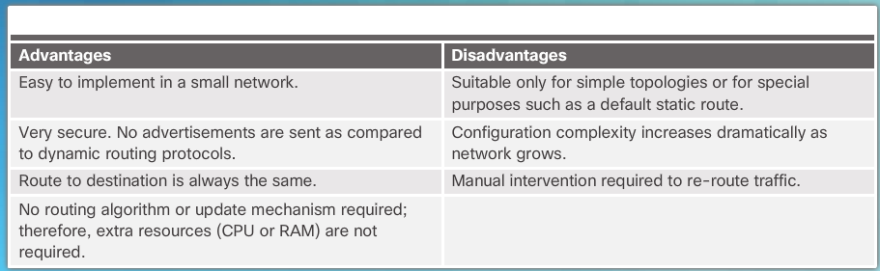
Dynamic versus Static Routing Static Routing Advantages and Disadvantages
Notes:
3.1 – Dynamic Routing Protocols
3.1.2 – Dynamic versus Static Routing
3.1.2.2 – Static Routing Advantages and Disadvantages

Slide 19
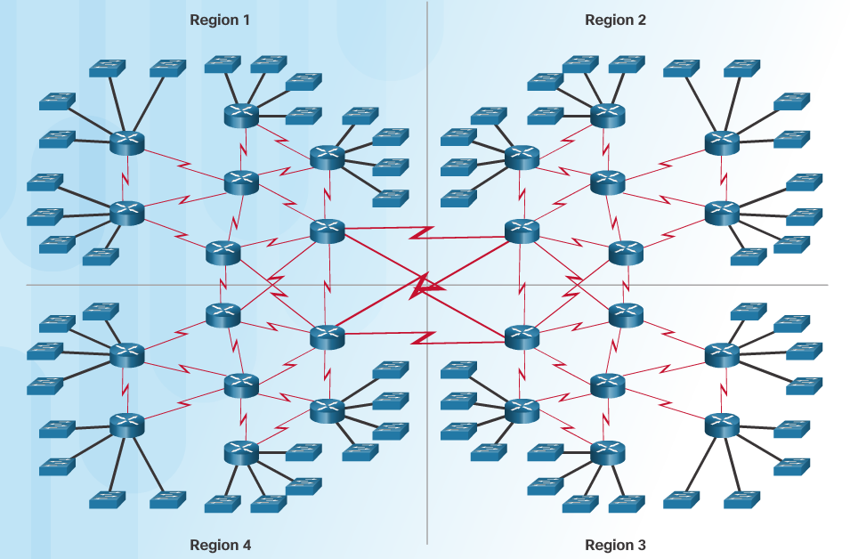
Dynamic versus Static Routing Dynamic Routing Protocols Uses
Dynamic routing is the best choice for large networks
Dynamic routing protocols help the network administrator manage the network:
Providing redundant paths
Automatically implementing the alternate path when a link goes down.
Notes:
3.1 – Dynamic Routing Protocols
3.1.2 – Dynamic versus Static Routing
3.1.2.3 – Dynamic Routing Protocols Uses

Slide 20
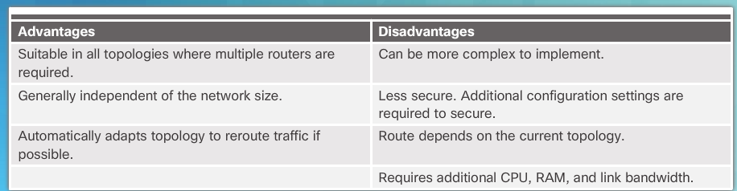
Dynamic versus Static Routing Dynamic Routing Advantages and Disadvantages
Notes:
3.1 – Dynamic Routing Protocols
3.1.2 – Dynamic versus Static Routing
3.1.2.4 – Dynamic Routing Advantages and Disadvantages

Slide 21
3.2 RIPv2
Notes:
3 – Dynamic Routing
3.2 – RIPv2

Slide 22
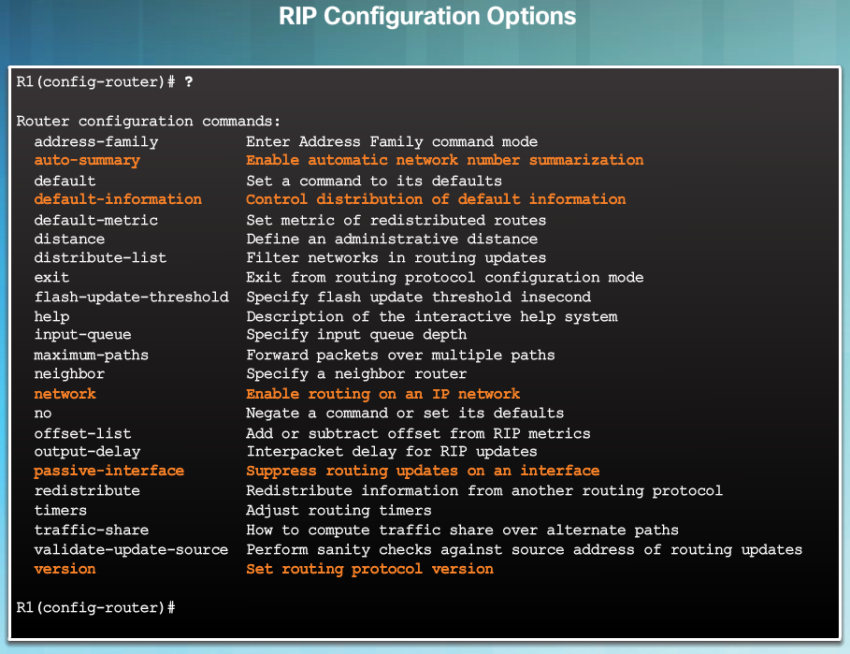
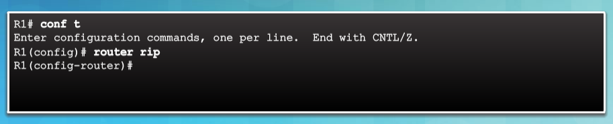
Dynamic versus Static Routing Router RIP Configuration Mode
Use the router rip command to enable RIP v1
Use the no router rip command to disable RIP
Notes:
3.2 – RIPv2
3.2.1 – Configuring the RIP Protocol
3.2.1.1 – Router RIP Configuration Mode

Slide 23
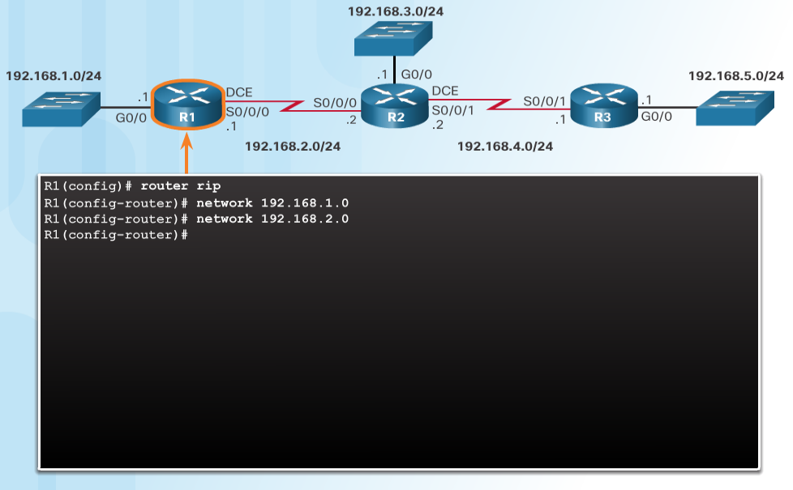
Configuring the RIP Protocol Advertise Networks
The network network-address router configuration mode command:
Enables RIP on all interfaces that belong to a specific network
Advertises the network in RIP routing updates sent to other routers every 30 seconds.
Note: RIPv1 is a classful routing protocol for IPv4.
Notes:
3.2 – RIPv2
3.2.1 – Configuring the RIP Protocol
3.2.1.2 – Advertise Networks

Slide 24
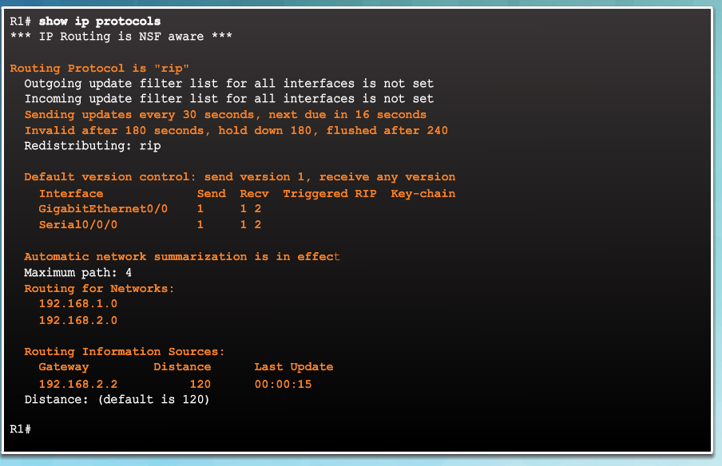
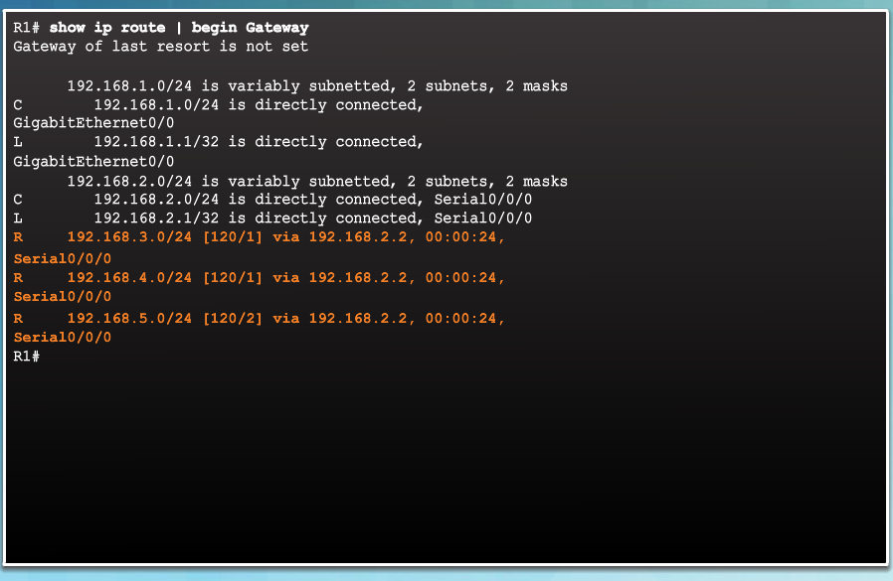
Configuring the RIP Protocol Verify RIP Routing
show ip route – displays RIP routes installed in the routing table.
show ip protocols – displays IPv4 routing protocols configured on the router.
Notes:
3.2 – RIPv2
3.2.1 – Configuring the RIP Protocol
3.2.1.3 – Verify RIP Routing

Slide 25
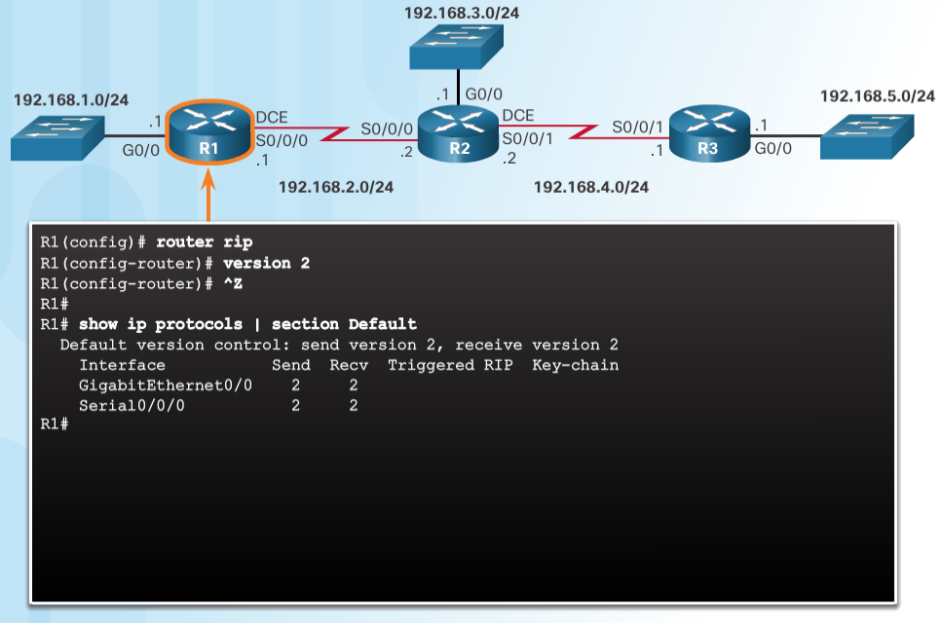
Configuring the RIP Protocol Enable and Verify RIPv2
Use the version 2 router configuration mode command to enable RIPv2
Use the show ip protocols command to verify that RIPv2 is configured.
Use the show ip route command to verify the RIPv2 routes in the routing table.
Notes:
3.2 – RIPv2
3.2.1 – Configuring the RIP Protocol
3.2.1.4 – Enable and Verify RIPv2

Slide 26
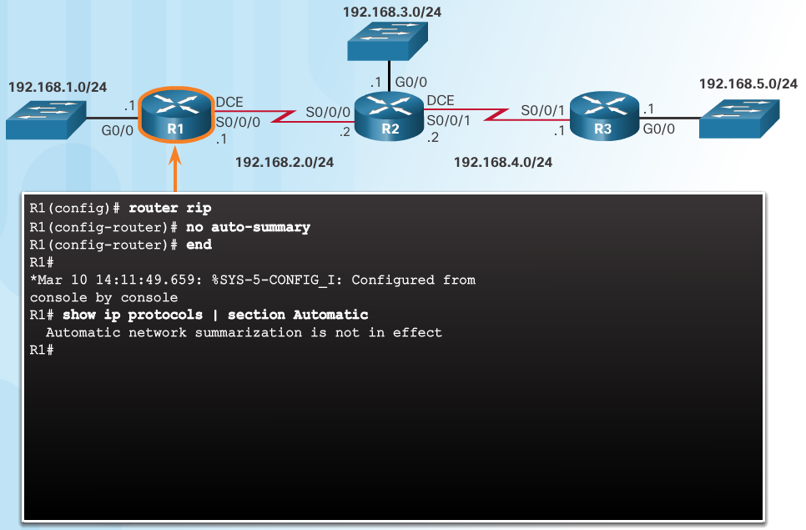
Configuring the RIP Protocol Disable Auto Summarization
RIPv2 automatically summarizes networks at major network boundaries.
Use the no auto-summary router configuration mode command to disable auto summarization.
Use the show ip protocols command to verify that auto summarization is off.
Notes:
3.2 – RIPv2
3.2.1 – Configuring the RIP Protocol
3.2.1.5 – Disable Auto Summarization

Slide 27
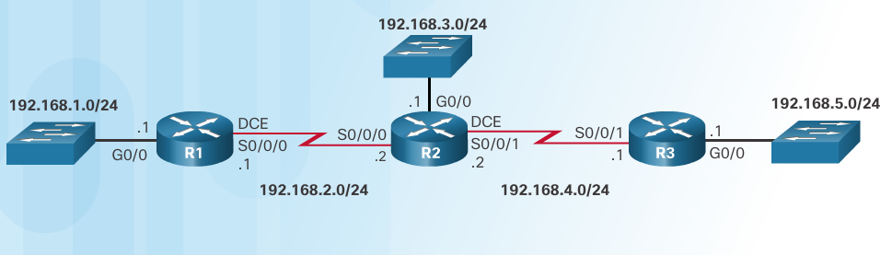
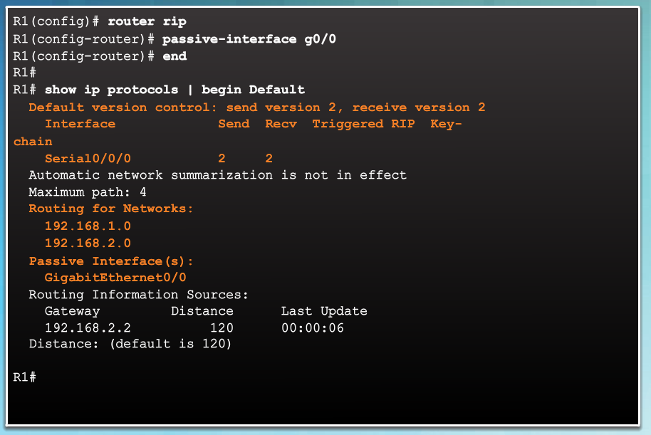
Configuring the RIP Protocol Configure Passive Interfaces
RIP updates:
Are forwarded out all RIP-enabled interfaces by default.
Only need to be sent out interfaces that are connected to other RIP-enabled routers.
Sending RIP updates to LANs wastes bandwidth, wastes resources, and is a security risk.
Use the passive-interface router configuration command to stop routing updates out the interface. Still allows that network to be advertised to other routers.
Notes:
3.2 – RIPv2
3.2.1 – Configuring the RIP Protocol
3.2.1.6 – Configure Passive Interfaces

Slide 28
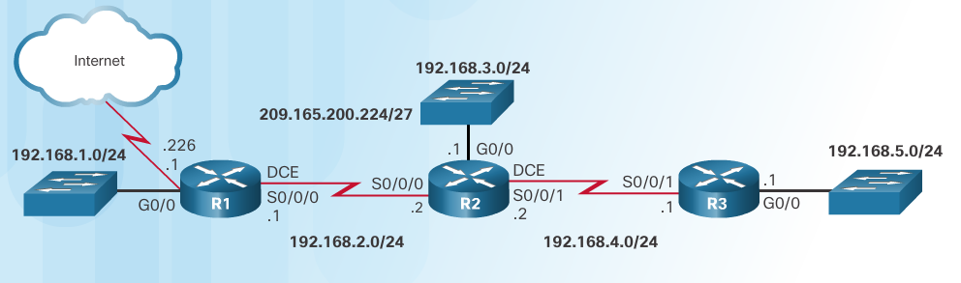
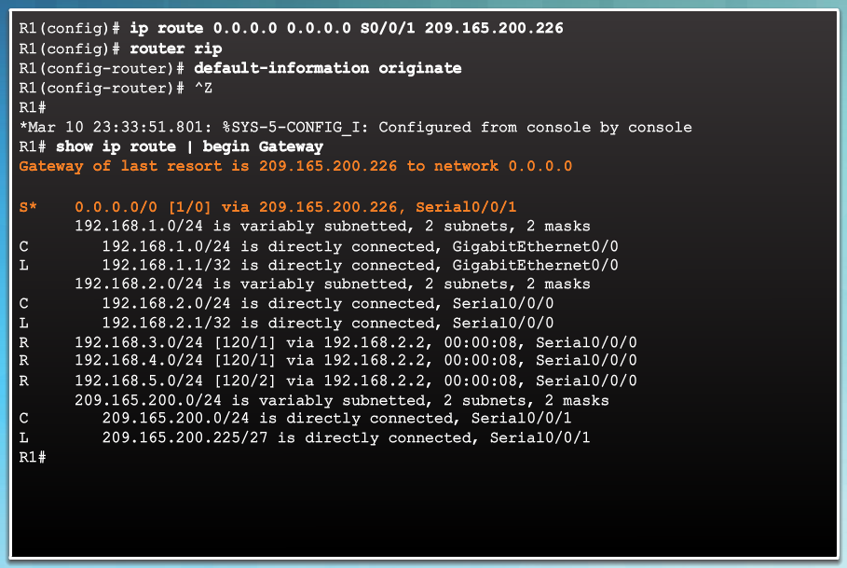
Configuring the RIP Protocol Propagate a Default Route
In the diagram a default static route to the Internet is configured on R1.
The default-information originate router configuration command instructs R1 to send the default static route information in the RIP updates.
Notes:
3.2 – RIPv2
3.2.1 – Configuring the RIP Protocol
3.2.1.7 – Propagate a Default Route

Slide 29
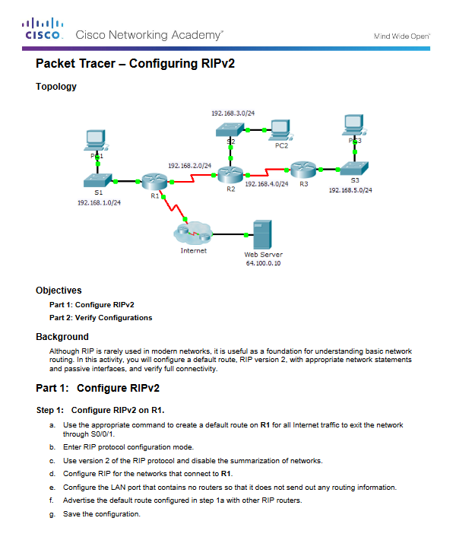
Configuring the RIP Protocol Packet Tracer - Configuring RIPv2
Notes:
3.2 – RIPv2
3.2.1 – Configuring the RIP Protocol
3.2.1.8 – Packet Tracer - Configuring RIPv2

Slide 30
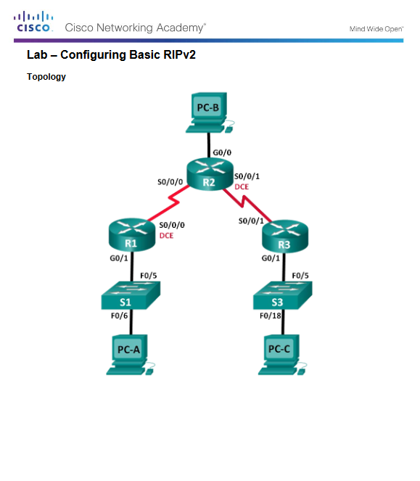
Configuring the RIP Protocol Lab - Configuring Basic RIPv2
Notes:
3.2 – RIPv2
3.2.1 – Configuring the RIP Protocol
3.2.1.9 – Lab - Configuring Basic RIPv2

Slide 31
3.3 The Routing Table
Notes:
3 – Dynamic Routing
3.3 – The Routing Table

Slide 32
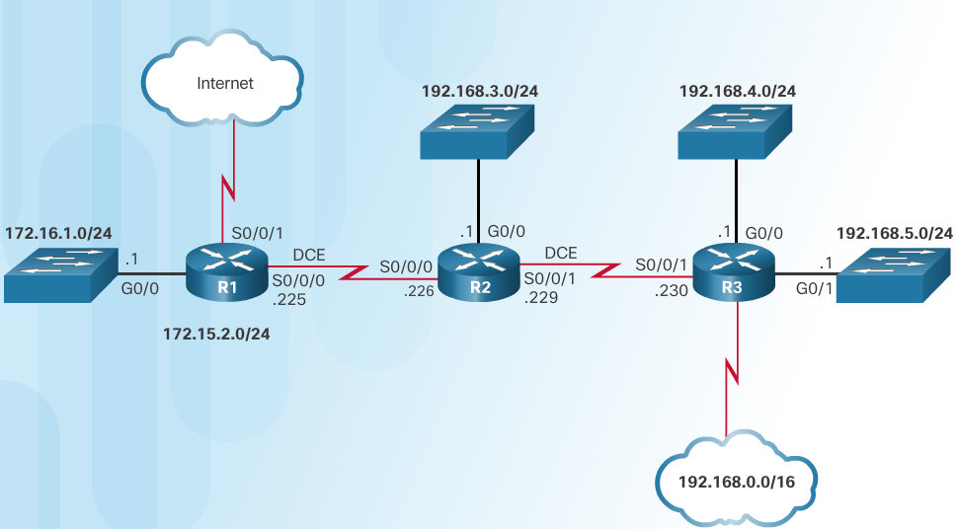
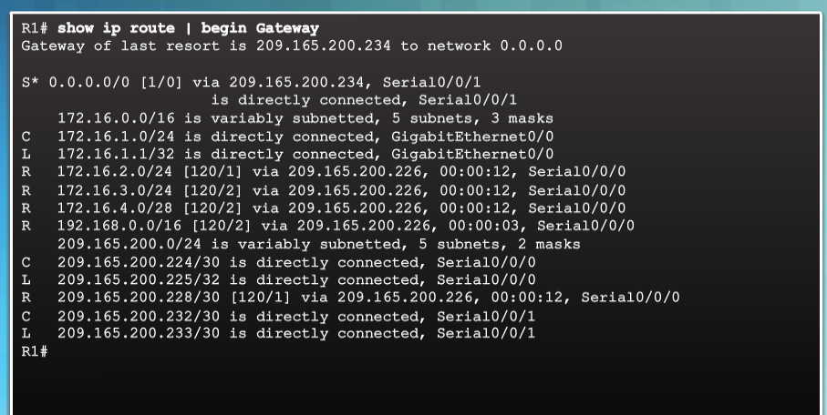
Parts of an IPv4 Route Entry Routing Table Entries
Routing Table for R1
Notes:
3.3 – The Routing Table
3.3.1 – Parts of an IPv4 Route Entry
3.3.1.1 – Routing Table Entries

Slide 33
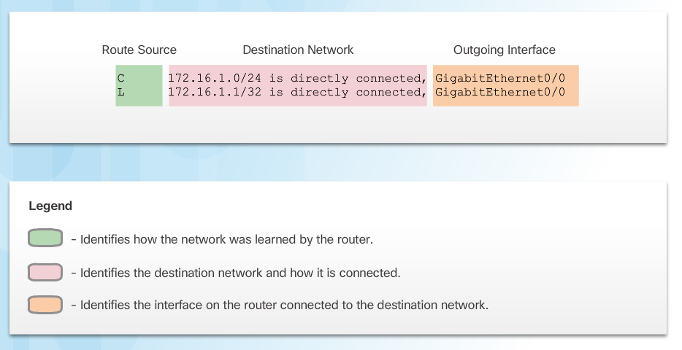
Parts of an IPv4 Route Entry Directly Connected Entries
Directly Connected Networks (C) are automatically added to the routing table when the interface is configured and activated.
Entries contain the following information:
Route source - how the route was learned.
Destination network – remote network.
Outgoing Interface – exit interface used to forward packets to destination.
Other route source entries include:
S –Static Route
D – EIGRP routing protocol
O – OSPF routing protocol
R - RIP routing protocol
Notes:
3.3 – The Routing Table
3.3.1 – Parts of an IPv4 Route Entry
3.3.1.2 - Directly Connected Entries

Slide 34
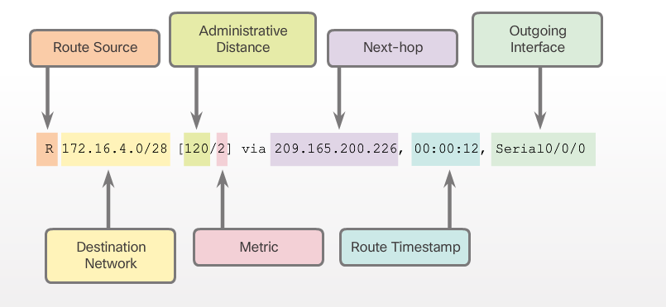
Parts of an IPv4 Route Entry Remote Network Entries
Routes to remote networks contain the following information:
Route source – how route was learned
Destination network
Administrative distance (AD) - trustworthiness of the route.
Metric – value assigned to reach the remote network. Lower is better.
Next hop – IPv4 address of the next router that the packet should be forwarded to.
Route timestamp – time since the route was updated.
Outgoing interface - the exit interface to use to forward the packet
Notes:
3.3 – The Routing Table
3.3.1 – Parts of an IPv4 Route Entry
3.3.1.3 - Remote Network Entries

Slide 35
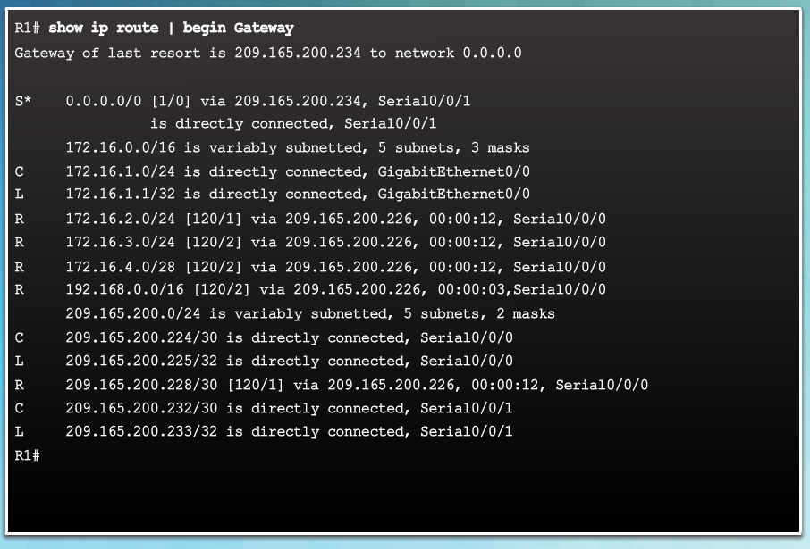
Dynamically Learned IPv4 Routes Routing Table Terms
The routing table is a hierarchical structure that is used to speed up the lookup process when locating routes and forwarding packets.
The hierarchy includes:
Ultimate Routes
Level 1 routes
Level 1 parent routes
Level 2 child routes
Notes:
3.3 – The Routing Table
3.3.2 – Dynamically Learned IPv4 Routes
3.3.2.1 - Routing Table Terms

Slide 36
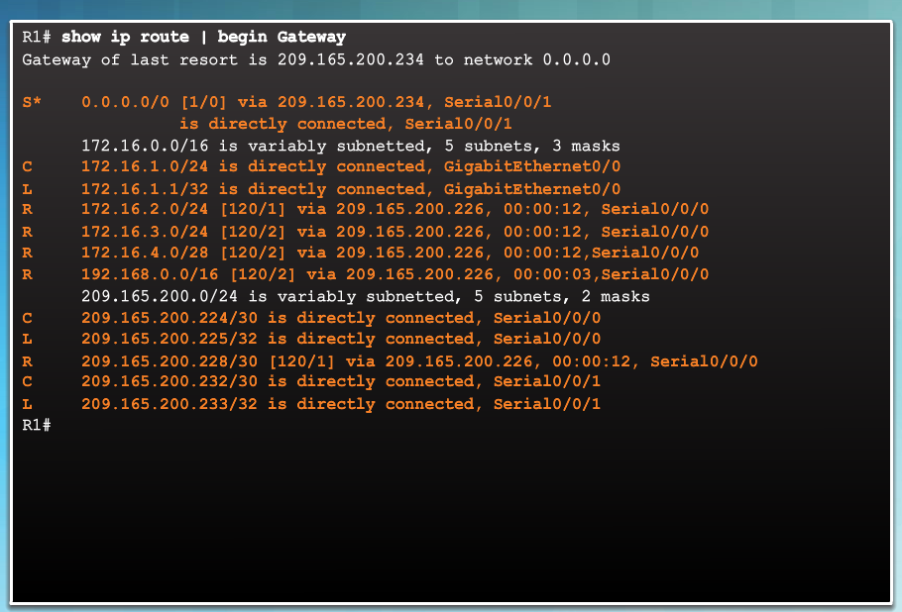
Dynamically Learned IPv4 Routes Ultimate Route
An ultimate route is a routing table entry that contains either a next-hop IPv4 address or an exit interface.
Directly connected, dynamically learned, and local routes are ultimate routes.
Notes:
3.3 – The Routing Table
3.3.2 – Dynamically Learned IPv4 Routes
3.3.2.2 - Ultimate Route

Slide 37
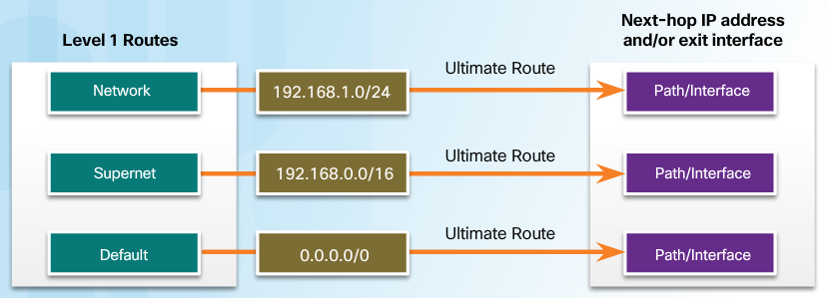
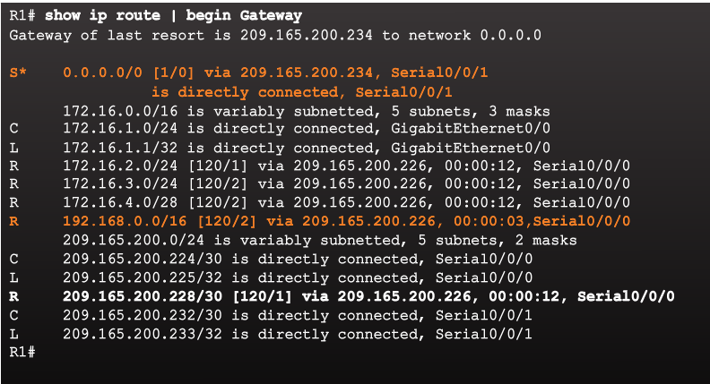
Dynamically Learned IPv4 Routes Level 1 Route
A level 1 route can be a:
Network route - a network route that has a subnet mask equal to that of the classful mask.
Supernet route - a network address with a mask less than the classful mask, for example, a summary address.
Default route - a static route with the address 0.0.0.0/0
Notes:
3.3 – The Routing Table
3.3.2 – Dynamically Learned IPv4 Routes
3.3.2.3 - Level 1 Route

Slide 38
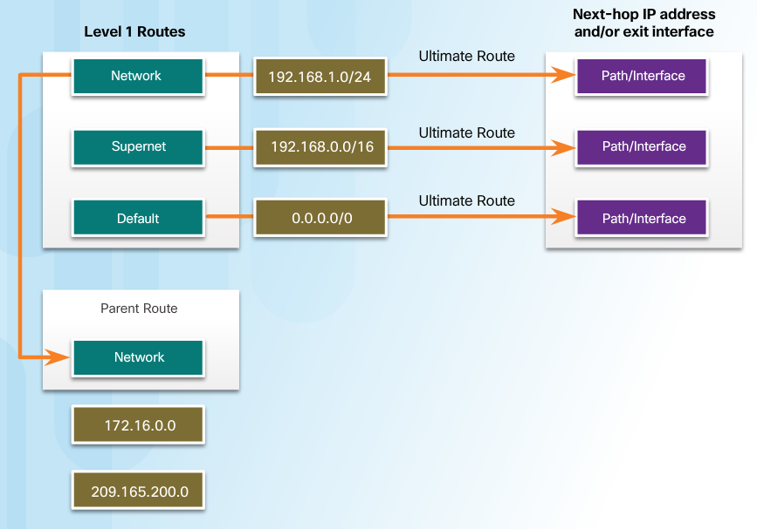
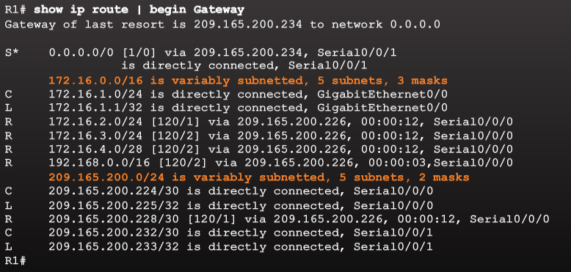
Dynamically Learned IPv4 Routes Level 1 Parent Route
A parent route is a level 1 network route that is subnetted.
In the routing table, it basically provides a heading for the specific subnets it contains.
Notes:
3.3 – The Routing Table
3.3.2 – Dynamically Learned IPv4 Routes
3.3.2.4 - Level 1 Parent Route

Slide 39
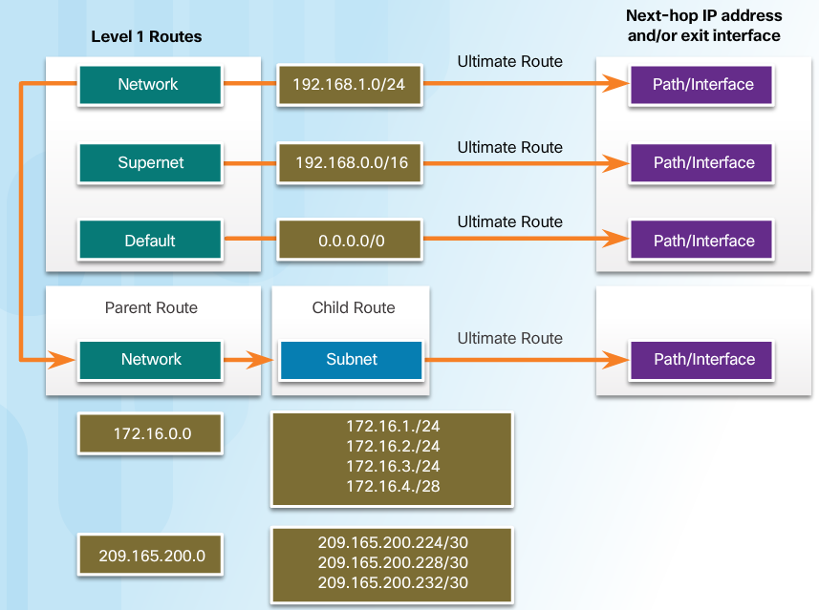
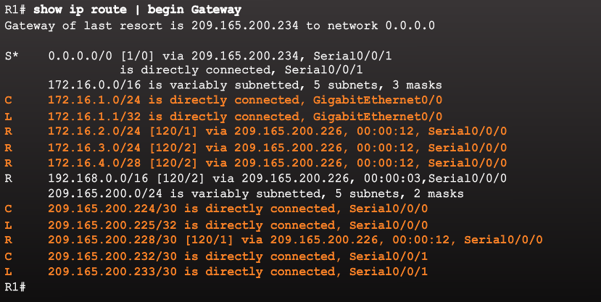
Dynamically Learned IPv4 Routes Level 2 Child Route
A level 2 child route is a route that is a subnet of a classful network address.
Level 1 parent routes contain level 2 child routes.
Level 2 child routes are also ultimate routes.
Notes:
3.3 – The Routing Table
3.3.2 – Dynamically Learned IPv4 Routes
3.3.2.5 - Level 2 Child Route

Slide 40
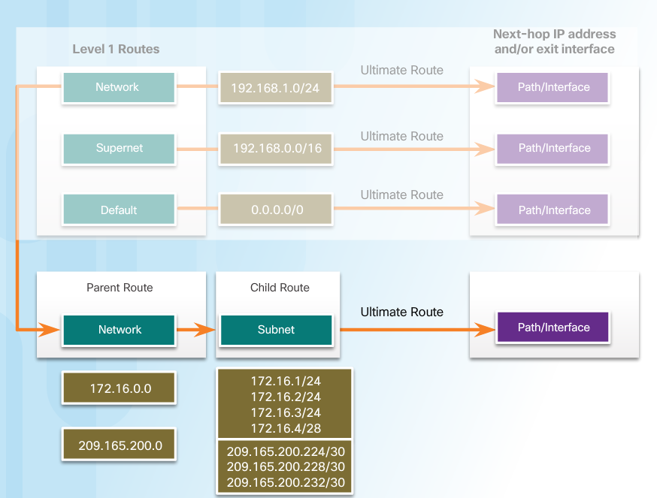
The IPv4 Route Lookup Process Route Lookup Process
Router lookup process:
If the best match is a level 1 ultimate route, then this route is used to forward the packet.
If the best match is a level 1 parent route, the router then examines child routes (the subnet routes).
If there is a match with a level 2 child route, that is used to forward the packet.
If there is no match with level 2 child routes, the router searches level 1 supernet or default routes. If there is a match, that route is used.
If there is no match found in the routing table the packet is dropped.
Notes:
3.3 – The Routing Table
3.3.3 – The IPv4 Route Lookup Process
3.3.3.1 - Route Lookup Process

Slide 41
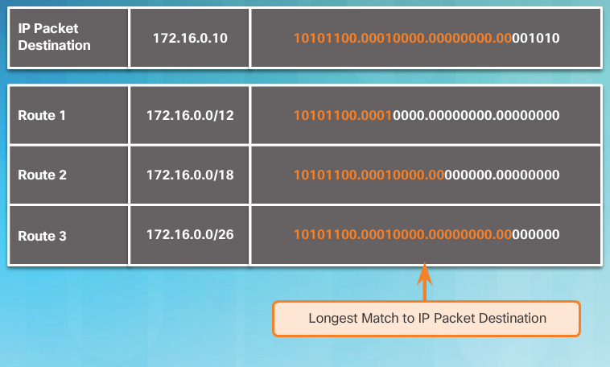
The IPv4 Route Lookup Process Best Route = Longest Match
The best match is the route in the routing table that has the most number of far left matching bits with the destination IPv4 address of the packet.
The route with the greatest number of equivalent far left bits, or the longest match, is always the preferred route.
Notes:
3.3 – The Routing Table
3.3.3 – The IPv4 Route Lookup Process
3.3.3.2 - Best Route = Longest Match

Slide 42
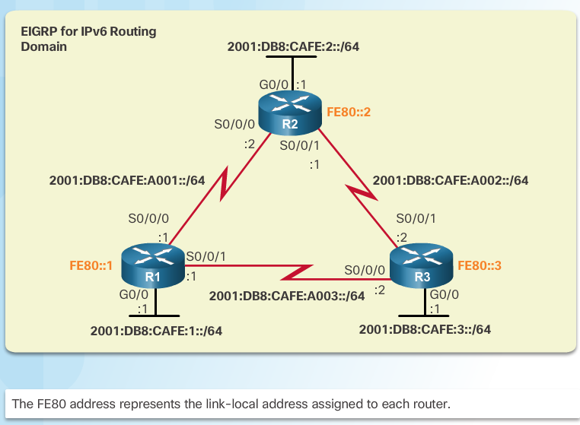
Analyze an IPv6 Routing Table IPv6 Routing Table Entries
An IPv6 routing table includes directly connected, static and dynamically learned routes.
All IPv6 routes are level 1 ultimate routes.
Notes:
3.3 – The Routing Table
3.3.4 – Analyze an IPv6 Routing Table
3.3.4.1 - IPv6 Routing Table Entries

Slide 43
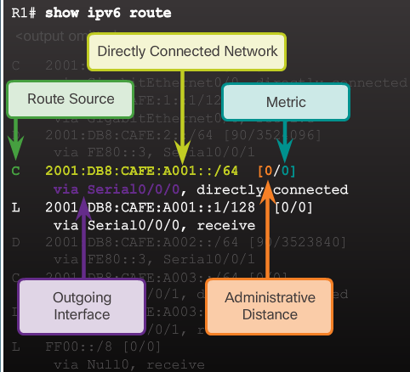
Analyze an IPv6 Routing Table Directly Connected Entries
Use the show ipv6 route command to display the IPv6 routing table.
The directly connected route entries include the following:
Route source – How the route was learned. Directly connected indicated with a C and L for local route.
Directly connected network address.
Administrative distance – Trustworthiness of the route (lower more trustworthy).
Metric – Value assigned to reach the network (lower is preferred route).
Outgoing interface – Exit interface used to forward packet.
Notes:
3.3 – The Routing Table
3.3.4 – Analyze an IPv6 Routing Table
3.3.4.2 - Directly Connected Entries

Slide 44
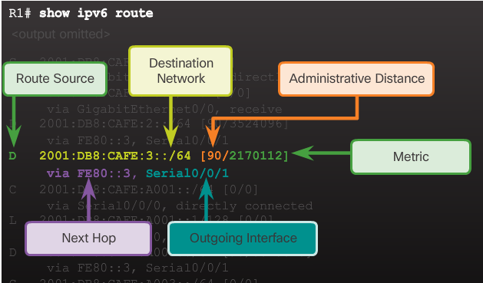
Analyze an IPv6 Routing Table Remote IPv6 Network Entries
The remote IPv6 route entries also include the following:
Route source – How the route was learned. Common codes include O (OSPF), D (EIGRP), R (RIP), and S (Static route).
Next hop - Identifies the IPv6 address of the next router to forward the packet to.
The IPv6 router lookup process:
Examines level 1 network routes for the best match.
Longest match is the best match.
Notes:
3.3 – The Routing Table
3.3.4 – Analyze an IPv6 Routing Table
3.3.4.3 - Remote IPv6 Network Entries

Slide 45
3.4 Chapter Summary
Notes:
3 – Dynamic Routing
3.4 – Summary

Slide 46
Conclusion Chapter 3: Dynamic Routing
Explain the function of dynamic routing protocols.
Implement RIPv2.
Determine the route source, administrative distance, and metric for a given route.
Notes:
3.4 – Summary
3.4.1 – Conclusion
3.4.1.2 – Chapter 3: Dynamic Routing

Slide 47
Chapter 3 New Terms and Commands
Routing Information Protocol (RIP)
RIPv1
RIPv2
Open Shortest Path First (OSPF)
Intermediate System-to-Intermediate System (IS-IS)
Interior Gateway Routing Protocol (IGRP)
Enhanced IGRP (EIGRP)
Border Gateway Protocol (BGP)
IPv4 addressing space
Data structures
Routing protocol messages
Algorithm
routing algorithm
classful routing protocol
classless routing protocol
automatic summarization
router rip
version 2
no router rip
network network-address
edge router
single-homed
propogate a default route
discontiguous networks
supernet
ultimate route
level 1 route
Network route
Supernet route
level 1 parent routes
level 2 child route
route lookup process
Notes:
Chapter 3: Dynamic Routing
New Terms and Commands

